Slide 1

READING BEHAVIOR STUDY
What Predicts Reading Behavior?
A data-driven exploration of American reading habits
2,832
Americans surveyed on book-reading habits, demographics & media consumption
Source: BigML American Reading Survey • Data Analysis Summary

Slide 2
Why Does This Matter?
Understanding who reads, and how much, informs decisions across four sectors
P
L
E
M
Publishers
Libraries
Education Policy
Media Companies
Target marketing and distribution to the readers most likely to buy
Allocate resources and programs to the communities that need them
Understand literacy trends and lifelong learning outcomes
Shape content strategy around real audience reading behavior
RESEARCH QUESTION
Can we predict heavy readers based solely on demographic features?
What Predicts Reading Behavior?
2

Slide 3
What we will discover
To unlock this, we asked:
Key Questions:
Who Reads and How much?
How demographics affect the reading habit?
Does Education affect ? And how much ?
Do gender and income affect ? And how much ?
How People read?
How to predict Heavy readers?
What Predicts Reading Behavior?
3

Slide 4
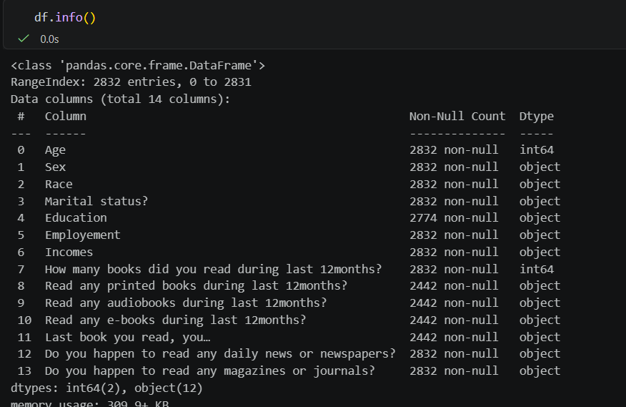
Dataset Overview
The raw data before data cleaning and preprocessing
2,832
Respondents
14
Features captured
Kaggle
Data source
What Predicts Reading Behavior?
4

Slide 5
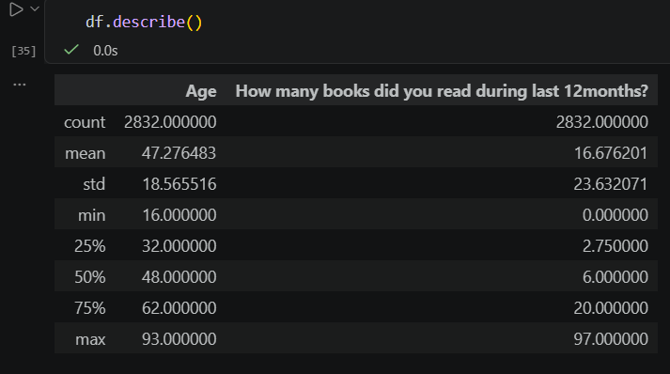
Statistical Summary
The main Statistical measures such as mean, standard deviation and The five-number summary
What Predicts Reading Behavior?
5

Slide 6
Data Preprocessing
A cleaned, imputation-ready dataset built for reliable modeling
DATA CLEANING STEPS
Missing values: 58 missing in Education; 390 in reading columns (non-readers skipped)
Data entry error fixed: “9$100,000 to under $150,000” corrected to “$100,000 to under $150,000”
Column naming: “Employement” renamed to “employment”; all columns standardized to snake_case
Missing Education: Imputed using the mode: “High school graduate”
Reading columns: Non-readers set to 0; others imputed with the median by education level
Outliers: IQR method — values capped at the upper fence
What Predicts Reading Behavior?
6

Slide 7
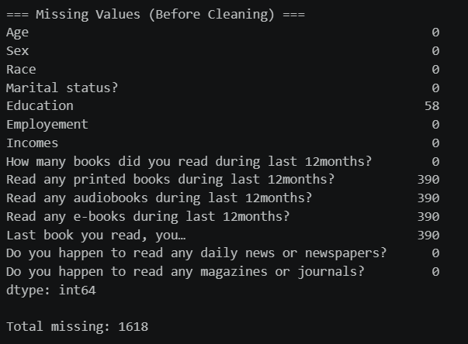
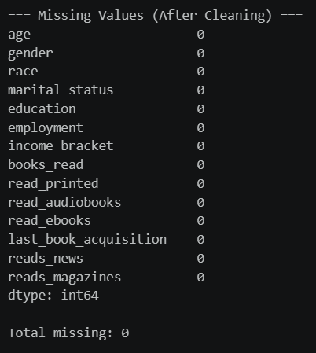
Data Preprocessing
Handling Missing Values
Missing values: 58 missing in Education; 390 in reading columns (non-readers skipped)
What Predicts Reading Behavior?
7

Slide 8
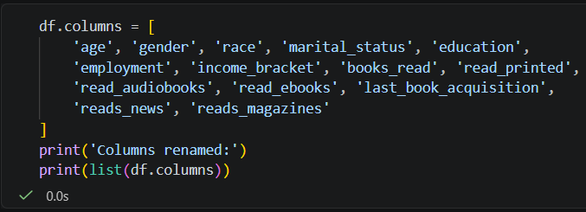
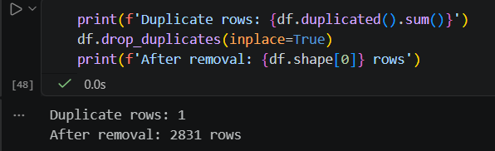
Data Preprocessing
Handling Duplicates & Rename Columns' Names
Column naming: “Employement” renamed to “employment”; all columns standardized to snake_case
Duplicate removing: one row removed
What Predicts Reading Behavior?
8

Slide 9
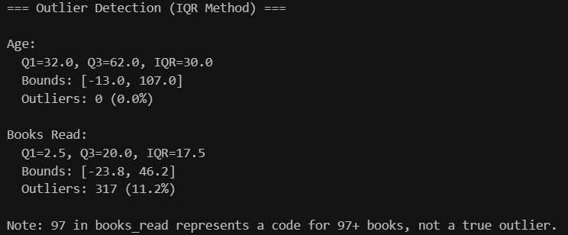
Data Preprocessing
Outlier Detection
Outliers: IQR method — values capped at the upper fence
What Predicts Reading Behavior?
9

Slide 10
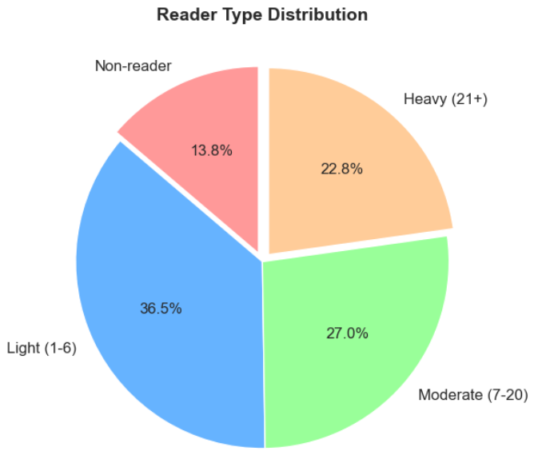
Who Reads?
80% of Americans read at least one book in the past year
6 books/year
Median reading rate across all respondents
Heavy readers
645 respondents — 22.8% read ≥ 21 books/year
Light readers
1,033 respondents 36.5%— % read 1–6 books/year
Non-readers
390 respondents — 13.8% read 0 books last year
Distribution is right-skewed: most readers read a few books, while a smaller, dedicated group reads heavily.
What Predicts Reading Behavior?
10

Slide 11
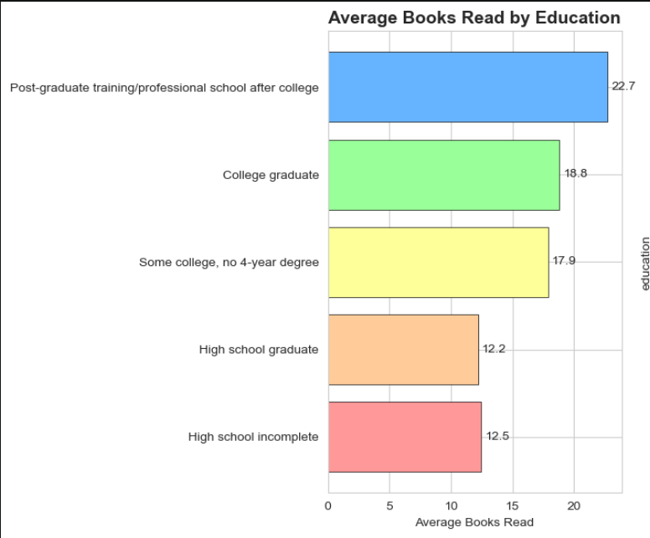
Education Is the #1 Predictor
Average books read per year, by highest education level
KEY INSIGHT
A college graduate is more likely to be a heavy reader than a high school graduate, all else being equal.
The logistic regression model confirms education carries the largest coefficient of any feature — the strongest single predictor of heavy reading.
What Predicts Reading Behavior?
11

Slide 12
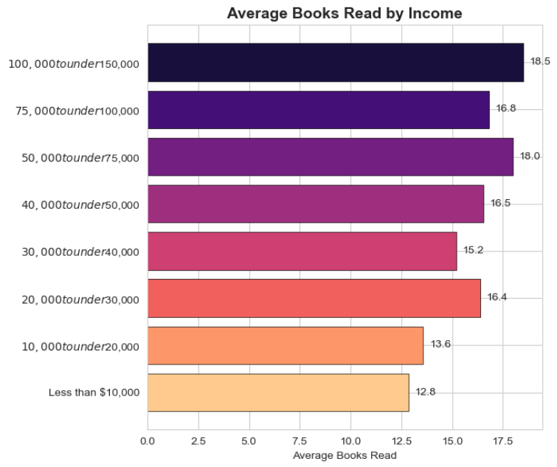
Income & Gender Also Matter
Two more demographic signals that correlate with reading volume
AVG BOOKS/YEAR BY INCOME
READING BY GENDER
19.7
books/year — Female
13.4
books/year — Male
Women read 6.3 more books/year than men on average — though the gap narrows once education and income are controlled for.
What Predicts Reading Behavior?
12

Slide 13
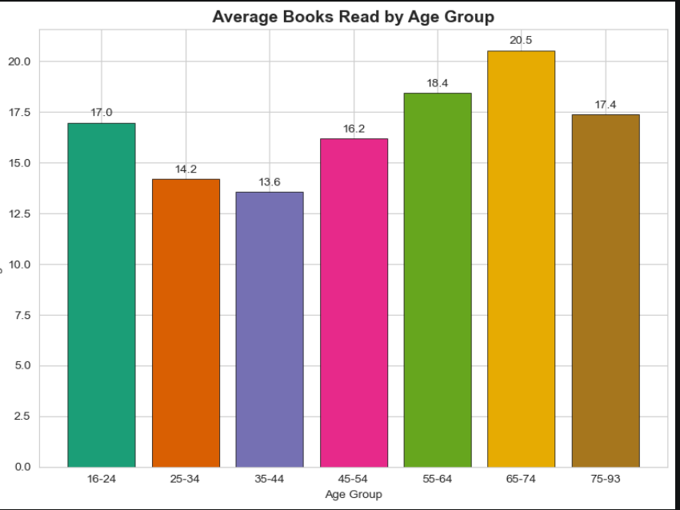
Age Has a Non-Linear Relationship
Reading peaks in the retirement years, not at the oldest ages
~20 books/yr
Ages 65–74 read the most of any group — reading peaks in retirement, not steadily with age.
EMPLOYMENT
Retired respondents read slightly more on average. Employment status offers some signal, but is far less powerful than education or income.
What Predicts Reading Behavior?
13

Slide 14
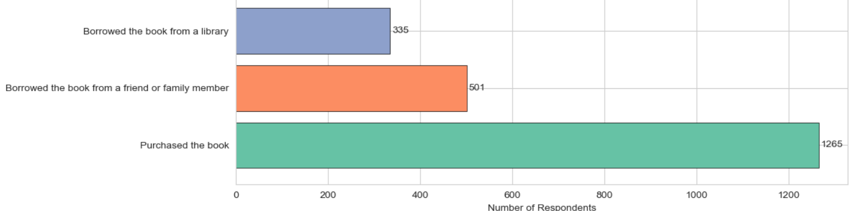
How People Read
Printed books still dominate, even as digital formats gain ground
FORMAT PREFERENCE (AMONG READERS)
MEDIA CONSUMPTION
61.8%
read daily news or newspapers
53.2%
read magazines or journals
HOW READERS ACQUIRE BOOKS
Reading habits extend beyond books into news and periodicals for a majority of respondents.
What Predicts Reading Behavior?
14

Slide 15
Predicting Heavy Readers
Logistic regression — classifying heavy readers (≥10 books) vs. all others
FEATURE IMPORTANCE (MODEL COEFFICIENTS)
FEATURES USED
Age, gender, education, employment, income, and marital status.
MODEL PERFORMANCE
Meaningful accuracy improvement over a random baseline, using balanced class weights to correct for the 22.6% heavy-reader imbalance. Education and income are the dominant factors in every prediction.
What Predicts Reading Behavior?
15

Slide 16
Key Takeaways & Limitations
WHAT WE FOUND
LIMITATIONS
80% of Americans read at least one book last year — median of 6 books/year
“97” represents “97 or more” books — likely underestimates heavy readers
Education is the #1 predictor: post-graduates read ~2x more than HS dropouts
Survey data may carry response bias (readers more likely to respond)
Income strongly correlates — higher earners read more
Age is non-linear: reading peaks among 65–74 year-olds
Only demographic features used; psychological and lifestyle data would improve predictions
Women read more than men: 19.7 vs. 13.4 books/year
Print still dominates (93%), though 33% also read e-books
No time period or geographic information included
A logistic regression model predicts heavy readers with meaningful accuracy
What Predicts Reading Behavior?
16

Slide 17
Thank You
17

